Slide 1
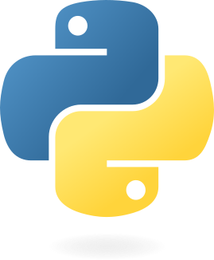

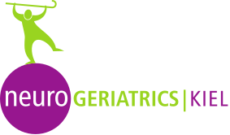
Python programming for the movement sciences
Philippe C. Dixon^{1,2}, Jill Emmerzaal¹, Clint Hansen³, Robbin Romijnders³, Vaibhav Shah² ,
McGill University. Department of Kinesiology and Physical Education
University of Montreal. Biomedical Engineering Institute
Kiel University, Department of Neurology

Slide 2
Why learn Python
Notes:
This seminar is hardly enough for you to learn Python. Therefore, the aim is to give you a crude introduction to the language and give you the basic knowledge needed to get started.
The information in the introduction will be enough to understand basic python concepts that you will inspect in the tutorials. The accompanying Jupyter Notebook is there as a very succinct reference guide that you can use during the seminar.
Our goal, in this first introduction, will be to help you understand the syntax of the python language and its environment. We will also strive to give you a basic understanding of the python documentation so you’ll be able to read and implement the different libraries.

Slide 3
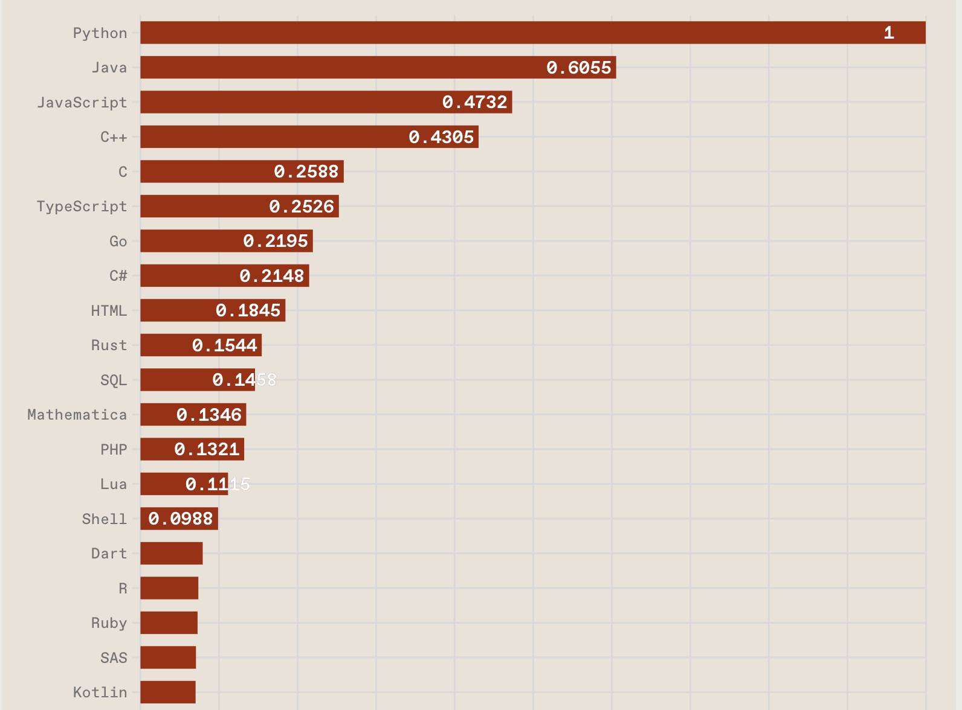
Why learn Python
Python is trending according to IEEE
Versatile with with broad applications
Free of charge
Has an easy, readable syntax
Extensive, powerful libraries
Interoperability with MATLAB
https://spectrum.ieee.org/top-programming-languages-2024

Slide 4
Extensive guides and references
If you are stuck, or you want to learn more, there are plenty of options
Ofiicial Python tutorial
NumPy for absolute beginners
Thonny--easy IDE for debugging
Udemy courses like 100 days of code or python for data science and machine learning bootcamp

Slide 5
Overview of content so far
We have officially started to learn python.
Python has powerful libraries to enhance the versatile use
Python and MATLAB can be used together

